Slide 1

Queens College Semester Course Database
Ridhwan ibrahim, youlun wang, giorgos stephanis, seeram govindan, hasan husseini, michael cipriani

Slide 2
Project Objectives
Transform source data From Uploadfile.CurrentSemesterCourseOfferings table into a Normalized database
Data Modeling
  Analyze the source table to identify data anomalies
  Identify the entities and attributes and any relationships
  Normalize to 3NF
  ERD diagram
  Determine organizational schemas and create Udts
  Create tables
ETL workflow using StoreProcedures
Generate propositions that showcase design choices

Slide 3
Analyzing Source Table
At first glance there were many missing values in different columns
Certain columns like Course (hr, crd) were non-atomic and could be split into further attributes
Ex: ACCT 100 (3, 3) contained DepartmentCode, CourseCode, CreditHours, and ContactHours
There were also multiple values in fields
Ex: Day contained multiple values for different Meeting days
Values contained decimals, (credit hour for example).
Large number of contact hours (SPAN 398 (135, 3) which needed to be fixed
Number of Enrolled people was greater than the EnrollmentLimit

Slide 4
Entity Identification
Determined the Entities in the DB
  Department – Represents an academic unit responsible for courses
  Course – Represents a catalog-level course
  Instructor – Represents the person teaching one or more classes
  InstructorDepartment – Represents the Department associated with an instructor
  Building - Represents a campus building identified by a building code.
  Room - Specific Room within a building
  ModeOfInstruction - Class delivery method (In-Person, Online)
  Class,ClassMeeting - Scheduled meeting occurrence for a class

Slide 5
Understanding Relationships
Identified how each entity relate to one another
Class represents a scheduled offering of a course, and depends on several parent entities
  Including Course, instructor, Room and mode of instruction
Understand the relationships between entities
  1 Department -> Many Courses
  1 Building -> Many Rooms
  1 Course -> Many class offerings
  1 Instructor -> Many Classes
  1 ModeOfInstruction -> Many Classes
  1 Room -> Many classes
  1 Class -> Many Class Meetings

Slide 6
Normalizing the Data 1NF
At this stage we need to ensure atomic values
The attributes of each entity
  Ex: [Course (hr, crd)] was decomposed to Department + CourseNumber + CreditHours + ContactHours
  [Instructor] -> became FirstName + LastName + FullName
  Location -> BuildingCode + RoomNumber
  Day and Time -> was normalized to DayOfWeek + StartTime + EndTime

Slide 7
Normalizing the Data 3NF
Identified transitive dependencies where non-key attributes depended on other non-key attributes
Removed transitive dependencies by creating separate tables:
  BuildingCode in source table moved to Building
  InstructionMode in source table moved to ModeOfInstruction
  Instructor attributes moved exclusively to the Instructor table

Slide 8
Resolving Many to Many relationships
We identified a M:N relationship between Instructor and Department. One instructor can be affiliated with multiple departments, and One department can have multiple instructors.
To resolve this M:M relationship we needed to create a bridge entity InstructorDepartments where it contains the foreign keys from both Instructors and Departments tables
Each row represents an instructor's affiliation with specific department

Slide 9
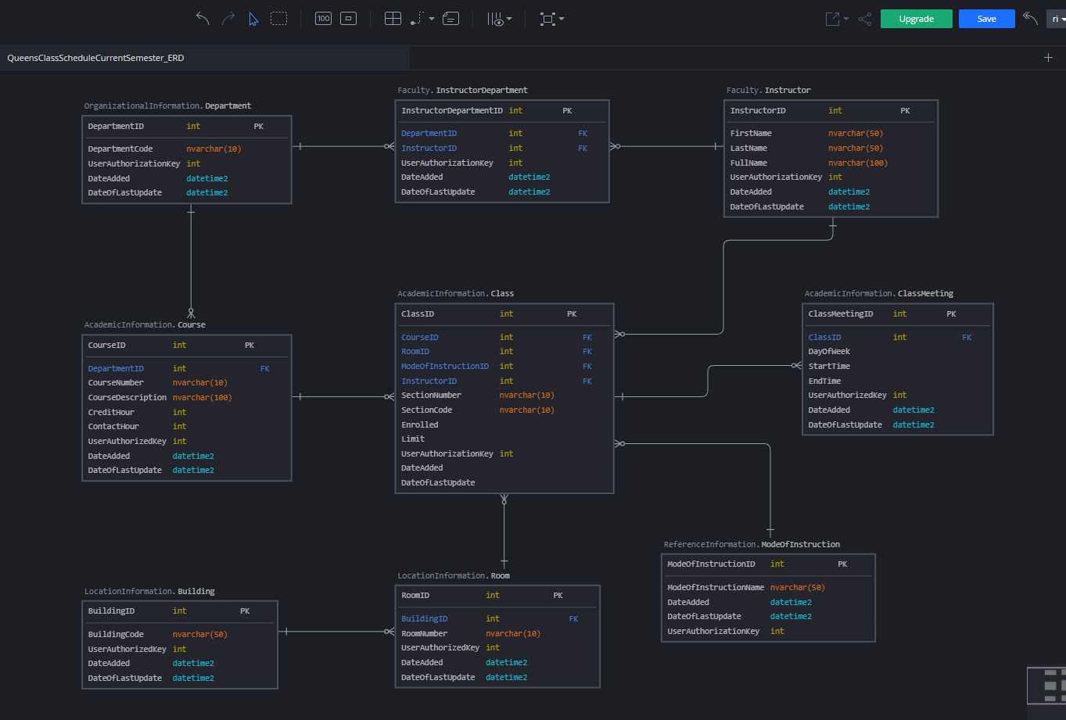

Slide 10
Schema Organization
We used schemas to separate tables by function and responsibility.
The main schemas include:
  AcademicInformation – Contains academic and schedule entities
  Faculty – Contains instructor and their departmental affliation data
  OrganizationalInformation – Represents academic structure of Queens college. Ex, Department
  LocationInformation – Contains physical location data. For example, building and room
  ReferenceInformation – Contains lookup/reference values for example, ModeOfInstruction
  DbSecurity – DbSecurity schema
  Process – Workflow schema
This structure allowed us to organize the data conceptually and define the business glossary domains.

Slide 11
UDTs
User Defined Data Types were created to standardize column definitions across the database.
Core UDTs such as SurrogateKeyInt, DateAdded, and DateOfLastUpdate were used in every table to enforce consistency.
Name-based UDTs (FirstName, LastName, FullName) were created after identifying inconsistent instructor name formatting in the source data.
Scheduling-related UDTs (DayOfWeek, ClassTime) were created due to inconsistent day and time values in the source table.
Numeric UDTs for CreditHours, ContactHours, and EnrollmentCount were adjusted to handle decimals and extreme values found in the source data.

Slide 12
Tables
Each table was created using a surrogate primary key defined by SurrogateKeyInt.
Surrogate keys were chosen to avoid reliance on unstable natural keys from the source data.
All tables include auditing columns: DateAdded and DateOfLastUpdate.
Unique constraints were added where appropriate to prevent duplicate logical records.
Check constraints were used to enforce business rules such as enrollment limits and valid credit hour ranges.
Persisted computed columns were used where required, such as Instructor FullName.

Slide 13
Course Table Design
Problem: Source data was unnormalized and messy.
Example: Course (hr, crd) column combined three data points into one string: "ANTH 101 (3,3)".
Issue: Impossible to query specific attributes like "Credits" or sort effectively by "Course Number."
Strict Typing: Uses User Defined Types (UDTs) like CreditHours and CourseNumber to enforce consistency across the schema.
Data Integrity: Implements Check Constraints to reject impossible data (e.g., Credits must be 0–6; Contact Hours must be 0–20).
Normalization (3NF): Stores DepartmentID rather than Department Name to eliminate redundancy.
Created separate fields for DepartmentID, CourseNumber, CreditHours, and ContactHours.

Slide 14
Course ETL Logic
Uses SUBSTRING and CHARINDEX to split the raw format "ANTH 101 (3,3)" into atomic columns (Number, Credits, Hours).
Digital Signature: Every row includes a UserAuthorizationKey to track the source of the data.
Time-Stamping: Automated tracking of data lifecycle .
DateAdded: Records insertion time.
DateOfLastUpdate: Tracks the most recent change.

Slide 15
Class
The class table represents a single offering of a course in the current semester
It is separate from the course table
The table connects multiple parent entities (class cannot exist without)
Course, Instructor, Room, ModeOfInstruction
Each class row represents one section of a course
Data anomalies found: Some rows had CurrentEnrolled more than EnrollmentLimit
Instructor names contained single characters (-)

Slide 16
Class Meeting
Problem in Source Data
Day column contained multiple values (e.g., M, W, T, TH)
Time column stored ranges as free-text strings
Some rows had missing or malformed values
Cleansing Actions
Split multi-day values into one row per DayOfWeek (1NF)
Standardized allowed day codes: M, T, W, TH, F, S, SU
Parsed time ranges into StartTime and EndTime
Converted times to consistent HH:MM format
Result
One ClassMeeting row represents one class, one day, one time interval
Fully atomic and schedule-ready data

Slide 17
Class Meeting (cont.)
Validation Rules Applied
Rejected rows with:
  NULL or malformed time values
  Missing day values
  Invalid time order (StartTime ≥ EndTime)
Enforced domain constraints on DayOfWeek
Data Integrity Guarantees
Meetings only loaded for valid parent Class records
Duplicate meetings prevented using natural meeting key
(ClassID + DayOfWeek + StartTime + EndTime)
Operational Controls
Additive-only ETL (safe to rerun)
Audit tracking via UserAuthorizationKey
Timestamped load events logged to WorkflowSteps

Slide 18
Department
Obtained DepartmentCode from non-atomic field [Course (hr, crd)]
Enforced formatting rule by requiring expected spacing pattern
Excluded NULL & malformed source rows
Deduplicated department values during load
Prevented destructive updates by using additive-only inserts
Maintained full audit trail via UserAuthenticationKey & timestamps
Result:
A clean, 3NF Department reference table derived from raw source data.

Slide 19
Instructor
Instructor names were standardized into a consistent format
  Source field: Uploadfile.CurrentSemesterCourseOfferings.[Instructor]
  Target fields: Faculty.Instructor.FirstName, LastName, and computed FullName
Cleaning Logic:
  Trims whitespace using LTRIM(RTRIM)
  Assumes format: LastName, FirstName
    LastName = text before comma
    FirstName = text after comma
    Invalid values (NULL, empty, ',', no comma) → default to “Staff”
Builds standardized FullName
  Staff + Staff → Staff
  Else → LastName, FirstName
FullName is persisted for consistent reuse

Slide 20
Instructor
Deduplication Methods:
  SELECT DISTINCT removes duplicates from source data
  NOT EXISTS prevents re-inserting existing instructors
  Matching key: (FirstName, LastName)
Inference:
  The ETL treats FirstName + LastName as the unique identifier for instructors.

Slide 21
InstructorDepartment
Data Cleaning:
  Links Instructors to Departments
  Uses already-cleaned Instructor.FullName
  Invalid or missing instructor values default to “Staff”
  Department code extracted from course text
Integrity & Duplication:
  SELECT DISTINCT removes duplicate source rows
  NOT EXISTS prevents re-inserting existing relationships
  UNIQUE (InstructorID, DepartmentID) enforces integrity
  Supports many-to-many instructor–department relationship

Slide 22
ModeofInstruction
Source column {Mode of Instruction } contained nulls, empty strings and inconsistent spacing
ETL logic trimmed whitespace using LTRIM / RTRIM
Empty or null values were standardized to a controlled default value
Select Distinct and unique constraint ensured no duplicate instruction modes
Data loaded into a reference ( lookup) table enforcing a controlled domain
Each load was logged using Workflow Steps capturing row counts execution time

Slide 23
Building
1) What this table represents
The Building table stores campus buildings using building codes (for example: KY)
No building names were made up because the source data only provides codes
2) How data was cleaned
Building codes are taken directly from the source and stored once to avoid duplicates
Each building gets a primary key (BuildingID), which keeps joins clean and stable
DateAdded and DateOfLastUpdate track when the record was created or changed
3) Why this design
Prevents repeating building codes across many rows
Matches exactly what the source data provides

Slide 24
Room
1) What this table represents
The Room table represents individual rooms within a building
Each room belongs to one building using a foreign key
2) How data was cleaned
Rooms are linked to buildings using BuildingID instead of repeating building codes
This removes redundancy and prevents mismatched building–room combinations
Dates are included to track changes
3) Why this design
Enforces a clear Building to Room hierarchy
Makes it impossible to store a room without a valid building
Makes location data easier to use

Slide 25
Propositions to Query
Instructors Teaching in Multiple Departments
Number of Instructors in Each Department
How may classes that are being taught that semester grouped by course and aggregating the total enrollment, total class limit and the percentage of enrollment.
Number of rooms per building
Which instructors teach the most classes
Which classes meet most frequently Classes can have multiple scheduled meetings, requiring a separate child table.
Which department has the highest enrollment

Slide 26
Query Results
Query results showed consistent relationships across tables
Aggregations produced accurate totals and percentages
No orphans' records were present after foreign key enforcement
Results matched expected business logic
This confirmed that Normalization, constraints and ETL logic were successful

Slide 27
Lessons Learned & Conclusions
Proper database design requires understanding the data before writing SQL
Normalization significantly improves data quality and query reliability
Constraints and foreign keys are essential for enforcing business rules
ETL execution strategy impacts performance and maintainability
Separating deign load and validation phases leads to more robust system
This Project demonstrated how conceptual modeling translates into a working database

